Slide 1
Replacement & Retention

Slide 2
LEARNING OUTCOMES
Explain replacement terminology and basics
Determine economic service life (ESL)
Perform replacement/retention study
Understand special situations in replacement
Perform replacement study over specified time
Calculate trade-in value of defender

Slide 3
Replacement Study Basics
Reasons for replacement study
Reduced performance
Altered requirements
Obsolescence
Terminology
Defender – Currently installed asset
Challenger – Potential replacement for defender
Market value (MV) – Value of defender if sold in open market
Economic service life – No. of years at which lowest AW of cost occurs
Defender first cost – MV of defender; used as its first cost (P) in analysis
Challenger first cost – Capital to recover for challenger (usually its P value)
Sunk cost – Prior expenditure not recoverable from challenger cost
Nonowner’s viewpoint – Outsider’s (consultant’s) viewpoint for objectivity

Slide 4
Example: Replacement Basics
An asset purchased 2 years ago for $40,000 is harder to maintain than expected. It can be sold now for $12,000 or kept for a maximum of 2 more years, in which case its operating cost will be $20,000 each year, with a salvage value of $9,000 two years from now. A suitable challenger will have a first cost of $60,000 with an annual operating cost of $4,100 per year and a salvage value of $15,000 after 5 years. Determine the values of
P, A, n, and S for the defender and challenger for an AW analysis.
Solution:
Defender: P = $-12,000; A = $-20,000; n = 2; S = $9,000
Challenger: P = $-60,000; A = $-4,100; n = 5; S = $15,000

Slide 5
Overview of a Replacement Study
Replacement studies are applications of the AW method
Study periods (planning horizons) are either specified or
unlimited
Assumptions for unlimited study period:
Services provided for indefinite future
Challenger is best available now and for future, and will be repeated in future life cycles
Cost estimates for each life cycle for defender and challenger remain the same
If study period is specified, assumptions do not hold
Replacement study procedures differ for the two cases

Slide 6
Economic Service Life
Economic service life (ESL) refers to the asset retention time (n) that yields its lowest equivalent AW
Determined by calculating AW for 1, 2, 3,…n years
General equation is:
Total AW = capital recovery – AW of annual operating costs
= CR – AW of AOC

Slide 7
Example: Economic Service Life
Determine the ESL of an asset which has the costs shown below. Let i = 10%
Year Cost,$/year Salvage value,$
0 - 20,000 -
1 -5,000 10,000
2 -6,500 8,000
3 - 9,000 5,000
4 -11,000 5,000
5 -15,000 3,000
Solution:
AW₁ = - 20,000(A/P,10%,1) – 5000(P/F,10%,1)(A/P,10%,1) + 10,000(A/F,10%,1) = $ -17,000
AW₂ = - 20,000(A/P,10%,2) – [5000(P/F,10%,1) + 6500(P/F,10%,2)](A/P,10%,2)
+ 8000(A/F,10%,2)
= $ -13,429
Similarly, AW₃ = $ -13,239 AW₄ = $ -12,864 AW₅ = $ -13,623
Economic service life is 4 years

Slide 8
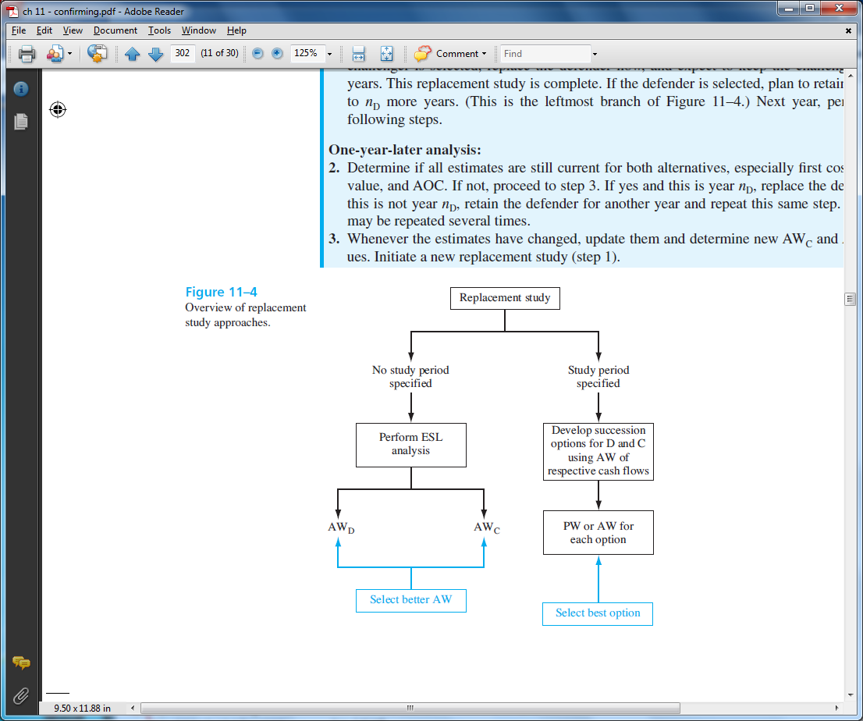
Performing a Replacement Study

Slide 9
Performing a Replacement Study --
Unlimited Study Period
1. Calculate AW_{D} and AW_{C} based on their ESL; select lower AW
2. If AW_{C} was selected in step (1), keep for n_{C} years (i.e., economic service life of challenger); if AW_{D} was selected, keep defender one more year and then repeat analysis (i.e., one-year-later analysis)
3. As long as all estimates remain current in succeeding years, keep defender until n_{D} is reached, and then replace defender with best challenger
If any estimates change before n_{D} is reached, repeat steps (1) through (4)
Note: If study period is specified, perform steps (1) through
(4) only through end of study period (discussed later)

Slide 10
Example: Replacement Analysis
An asset purchased 2 years ago for $40,000 is harder to maintain than expected. It can be sold now for $12,000 or kept for a maximum of 2 more years, in which case its operating cost will be $20,000 each year, with a salvage value of $10,000 after 1 year or $9000 after two years. A suitable challenger will have an annual worth of $-24,000 per year. At an interest rate of 10% per year, should the defender be replaced now, one year from now, or two years from now?
Solution: First, determine ESL for defender
AW_{D1} = -12,000(A/P,10%,1) – 20,000 + 10,000(A/F,10%,1) = $-23,200
AW_{D2} = -12,000(A/P,10%,2) – 20,000 + 9,000(A/F,10%,2) = $-22,629
ESL is n = 2 years; AW_{D} = $-22,629
AW_{C} = $-24,000
Lower AW = $-22,629 Replace defender in 2 years
Note: conduct one-year-later analysis next year

Slide 11
Additional Considerations
Opportunity cost approach is the procedure that was previously
presented for obtaining P for the defender. The opportunity cost is the
money foregone by keeping the defender (i.e., not selling it). This
approach is always correct
Cash flow approach subtracts income received from sale of
defender from first cost of challenger.
Potential problems with cash flow approach:
Provides falsely low value for capital recovery of challenger
Can’t be used if remaining life of defender is not same as that
of challenger

Slide 12
Replacement Analysis Over Specified Study Period
Same procedure as before, except calculate AW values
over study period instead of over ESL years of n_{D} and n_{C}
It is necessary to develop all viable defender-challenger
combinations and calculate AW or PW for each one over
study period
Select option with lowest cost or highest income

Slide 13
Example: Replacement Analysis; Specified Period
An asset purchased 2 years ago for $40,000 is harder to maintain than expected. It can be sold now for $12,000 or kept for a maximum of 2 more years, in which case its operating cost will be $20,000 each year, with a salvage value of $10,000 after 1 year or $9000 after two. A suitable challenger will have an annual worth of $-24,000 per year. At an interest rate of 10% per year and over a study period of exactly 2 years, determine when the defender should be replaced.
Solution: From previous analysis, AW_{D} for 1 and 2 years, and AW_{C} are:
AW_{D1} = $-23,200
AW_{D2} = $-22,629
AW_{C} = $-24,000
Option | Year 1, $ | Year 2, $ | Year 3, $ | AW, $
1 (C, C, C) | -24,000 | -24,000 | -24,000 | -24,000
2 (D, C, C) | -23,200 | -24,000 | -24,000 | -23,708
3 (D, D, C) | -23,200 | -22,629 | -24,000 | -23,042
Decision: Option 3; Keep D for 2 years, then replace

Slide 14
Replacement Value
Replacement value (RV) is market/trade-in value of
defender that renders AW_{D} and AW_{C} equal to each other
Set up equation AW_{D} = AW_{C} except use RV in place of P for
the defender; then solve for RV
If defender can be sold for amount > RV, challenger is
the better option, because it will have a lower AW value

Slide 15
Example: Replacement Value
An asset purchased 2 years ago for $40,000 is harder to maintain than expected. It can be sold now for $12,000 or kept for a maximum of 2 more years, in which case its operating cost will be $20,000 each year, with a salvage value of $10,000 at the end of year two. A suitable challenger will have an initial cost of $65,000, an annual cost of $15,000, and a salvage value of $18,000 after its 5 year life. Determine the RV of the defender that will render its AW equal to that of the challenger, using an interest rate of 10% per year. Recommend a course of action.
Solution: Set AW_{D} = AW_{C}
- RV(A/P,10%,2) - 20,000 + 10,000(A/F,10%,2) = - 65,000(A/P,10%,5) -15,000
+18,000(A/F,10%,5)
RV = $24,228
Thus, if market value of defender > $24,228, select challenger

Slide 16
Summary of Important Points
In replacement study, P for presently-owned asset is its market value
Economic service life is the n value that yields lowest AW
In replacement study, if no study period is specified, calculate AW over
the respective life of each alternative
Opportunity cost approach is correct, it recognizes money foregone
by keeping the defender, not by reducing challenger’s first cost
When study period is specified, must consider all viable defender-challenger
combinations in analysis
Replacement value (RV) is P value for defender that renders its AW equal to
that of challenger

